Slide 1
Chapter 4 Network Layer
Dr. Nilesh Patil
DJSCE

Slide 2
Network Layer Design Issues
Network layer is majorly focused on getting packets from the source to the destination, routing, error handling and congestion control.
It is the lowest layer that deals with end-to-end transmission.
The network layer comes with some design issues described as follows:
Store and Forward packet switching
Services provided to Transport Layer (Connectionless, Connection-Oriented)
Implementation of Connectionless Service
Implementation of Connection Oriented service (Circuit Switched Connection, Virtual Circuit Switched Connection)

Slide 3
Circuit – Switching | Packet – Switching
Circuit switching is a method that is used when a dedicated channel or circuit needs to be established. | Packet switching is a method of grouping data which is transmitted over a digital network into packets.
Circuit switching connections are classified into two categories half-duplex or full-duplex. | Packet Switching is a connectionless network switching method.
You need to establish a dedicated path between the source and the destination before the transfer of data commences. | You do not need to establish a dedicated path from the source to the destination.
It was initially designed for voice transfer. | It was initially designed for data transfer.
It is implemented at Physical Layer. | It is implemented at Network Layer.
In-Circuit switching, data is processed and transmitted at the source only. | In packet switching, data is processed and transmitted, not only at the source but also at the destination.
Its initial cost is low. | Packet switching demands high installation costs.
The protocols for delivery are simpler. | It requires complex protocols for delivery.
Charging happens per minute. | Charging happens per packet.
Each packet follows the same route. | Each packet does not follow the same route.
It does not store and forward transmission. | It does store and forward transmission.
Initially designed for Voice communication. | Initially designed for Data Transmission.
It is an inflexible method because once a path is set, all parts of a transmission follow the same path. | It is a flexible method because the route is created for each packet to travel to the destination.
The message is received in the order, which is sent from the source. | In, packet switching message are received out of order, which is assembled at the destination.
Reserve the entire Bandwidth in advance. | Never reserves the Bandwidth.
You can achieve Circuit switching using two technologies 1) Time or 2) Space Division Switching. | Packet Switching has Datagram Virtual Circuit Approach.

Slide 4
Key | Virtual Circuits | Datagram Networks
Definition | Virtual Circuit is a connection-oriented service in which there is an implementation of resources like buffers, CPU, bandwidth, etc., used by virtual circuit for a data transfer session. | Datagram networks are a type of connectionless service where no such resources are required for data transmission.
Path | In Virtual circuits, as all the resources and bandwidth get reserved before the transmission, the path which is utilized or followed by first data packet would get fixed and all other data packets will use the same path and consume same resources. | In a Datagram network, the path is not fixed as data packets are free to decide the path on any intermediate router on the go by dynamically changing routing tables on routers.
Header | As there is same path followed by all the data packets, a common and same header is being used by all the packets. | Different headers with information of other data packet is being used in Datagram network.
Complexity | Virtual Circuit is less complex as compared to that of Datagram network. | Datagram network are more complex as compared to Virtual circuit.
Reliability | Due to fixed path and assurance of fixed resources, Virtual Circuits are more reliable for data transmission as compared to Datagram network. | Datagram networks, due to their dynamic resource allocation and dynamic path, are more errorprone and less reliable than Virtual circuits.
Example and Cost | Virtual circuits are costlier in installation and maintenance. They are widely used by ATM (Asynchronous Transfer Mode) Network, which is used for the Telephone calls. | Datagram networks are cheaper as compared to the Virtual Circuits. They are mainly used by IP network, which is used for Data services like Internet.

Slide 5
Communication Primitives
Data is transported over a network by three simple methods i.e. Unicast, Broadcast, and Multicast.
Unicast: From one source to one destination i.e. One-to-One. Example: Telephone call
Broadcast: From one source to all possible destinations i.e. One-to-All Example: Cable Television
Multicast: From one source to multiple destinations stating an interest in receiving the traffic i.e. One-to-Many. Example: Email

Slide 6
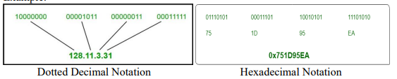
IPv4 Addressing
The IPv4 address is a 32-bit number that uniquely identifies a network interface on a system.
An IP address can be written in three notations; dotted-decimal, binary and hexadecimal.
Among these types, dotted-decimal is the most popular and frequently used method for writing an IP address.
An IPv4 address written in decimal digits is divided into four 8-bit fields that are separated by periods. Each 8-bit field represents a byte of the IPv4 address.
Some points to be noted about dotted decimal notation:
The value of any segment (byte) is between 0 and 255 (both included).
There are no zeroes preceding the value in any segment (054 is wrong, 54 is correct).

Slide 7
Classfull IP Addressing
The 32 bit IP address is divided into five sub-classes.
These are:
Class A
Class B
Class C
Class D
Class E
Each of these classes has a valid range of IP addresses.
Classes D and E are reserved for multicast and experimental purposes respectively.
IPv4 address is divided into two parts:
Network ID
Host ID
The class of IP address is used to determine the bits used for network ID and host ID and the number of total networks and hosts possible in that particular class.
Each ISP or network administrator assigns IP address to each device that is connected to its network.
IP addresses are globally managed by Internet Assigned Numbers Authority(IANA) and regional Internet registries(RIR).
While finding the total number of host IP addresses, two IP addresses are not counted and are therefore, decreased from the total count because the first IP address of any network is the network number and whereas the last IP address is reserved for broadcast IP.

Slide 8
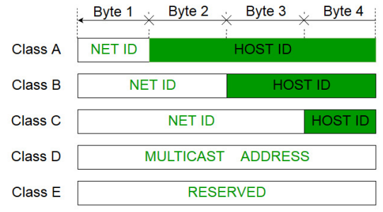
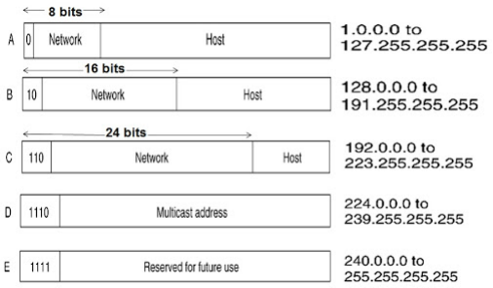
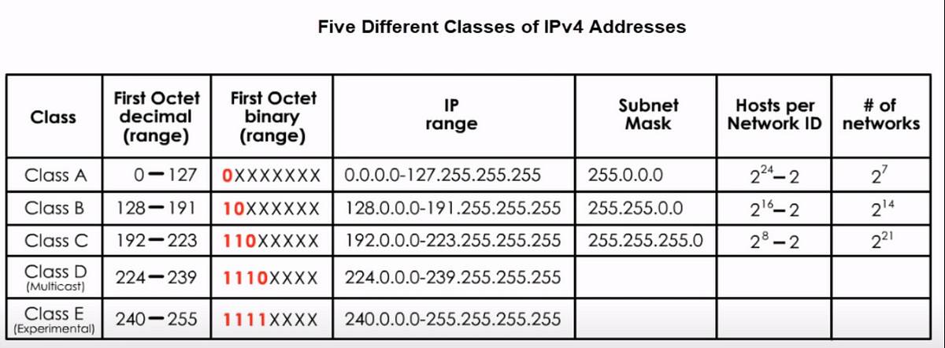

Slide 9
Range of special IP addresses
169.254.0.0 – 169.254.0.16: Link local addresses
127.0.0.0 – 127.0.0.8: Loop-back addresses
0.0.0.0 – 0.0.0.8: used to communicate within the current network.

Slide 10
Problems with Classfull Addressing
The problem with this Classfull addressing method is that millions of class A address are wasted, many of the class B address are wasted, whereas, number of addresses available in class C is so small that it cannot cater the needs of organizations.
Class D addresses are used for multicast routing and are therefore available as a single block only.
Class E addresses are reserved.
Since there are these problems, Classfull networking was replaced by Classless Inter-Domain Routing (CIDR) in 1993.

Slide 11

Find the class of the following IP address.

Slide 12
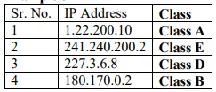
Find the class of the following IP address.
Solution:

Slide 13
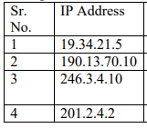
Find the netid and hostid for the following.

Slide 14
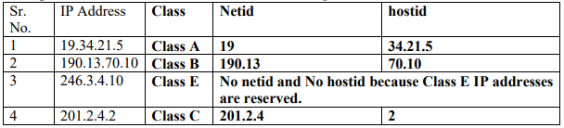
Find the netid and hostid for the following.
Solution:

Slide 15
Extracting Information in a Block of Classful IP Address
A block is a range of IP address.
Given any address in the block, we normally like to know the number of addresses, the first address, and the last address about the block.
Before extracting this information, we need to know the class of the IP address.
Once the class of the block is found, we know the value of ‘n’, the length of netid in bits.
The number of addresses N in the block can be found using N = 2^{32−n}.
To find the first address, we keep the ‘n’ leftmost bits and set the (32 – n) rightmost bits all to 0s.
To find the last address, we keep the ‘n’ leftmost bits and set the (32 – n) rightmost bits all to 1s.

Slide 16
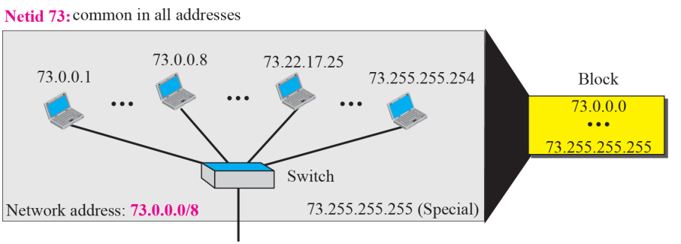
Q. An address in the block is given as 73.25.16.27. Find the number of addresses in the block, the first address, and the last address.
Solution:
Since 73 is between 0 and 127, the class of IP address is A. The value of n for class A is 8.
The number of addresses N in the block can be found using
N = 2^{32−n} = 2³²⁻⁸ = 2²⁴ = 16,777,216
To find the first address, we keep the n = 8 leftmost bits and set the (32 – 8) = 24 rightmost bits all to 0s. Hence, the first address is 73.0.0.0 which is also called the network address and is not assigned to any host. It is used to define the network.
To find the last address, we keep the n = 8 leftmost bits and set the (32 – n) = 24 rightmost bits all to 1s. Hence, the last address is 73.255.255.255 which is normally used for special purpose.
Figure shows a possible configuration of the network that uses this block.

Slide 17
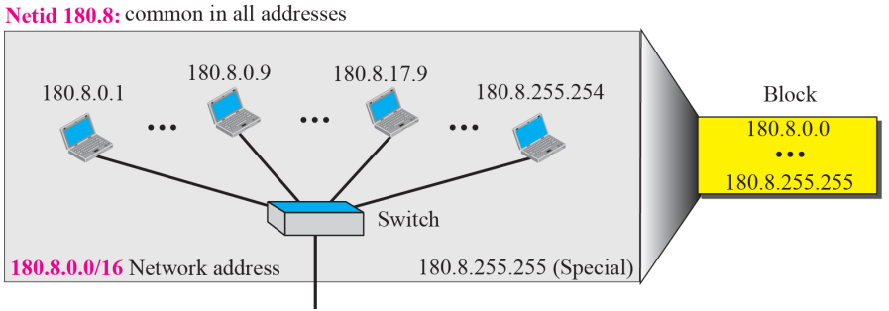
Q. An address in a block is given as 180.8.17.9. Find the number of addresses in the block, the first address, and the last address.
Solution:
Since 180 is between 128 and 191, the class of IP address is B. The value of n for class B is 16.
The number of addresses N in the block can be found using
N = 2^{32−n} = 2³²⁻¹⁶ = 2¹⁶ = 65,536
To find the first address, we keep the n = 16 leftmost bits and set the (32 – 16) = 16 rightmost bits all to 0s. Hence, the first address is 180.8.0.0 which is also called the network address and is not assigned to any host. It is used to define the network.
To find the last address, we keep the n = 8 leftmost bits and set the (32 – n) = 16 rightmost bits all to 1s. Hence, the last address is 180.8.255.255 which is normally used for special purpose.
Figure shows a possible configuration of the network that uses this block.

Slide 18
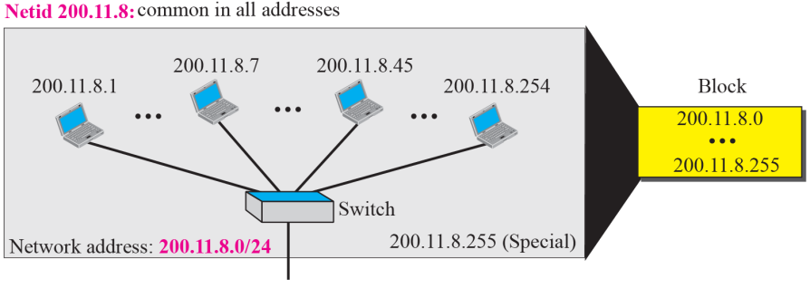
Q. An address in a block is given as 200.11.8.45. Find the number of addresses in the block, the first address, and the last address.
Solution:
Since 200 is between 192 and 223, the class of IP address is C. The value of n for class C is 24.
The number of addresses N in the block can be found using
N = 2^{32−n} = 2³²⁻²⁴ = 2⁸ = 256
To find the first address, we keep the n = 24 leftmost bits and set the (32 – 24) = 8 rightmost bits all to 0s. Hence, the first address is 200.11.8.0 which is also called the network address and is not assigned to any host. It is used to define the network.
To find the last address, we keep the n = 24 leftmost bits and set the (32 – 24) = 16 rightmost bits all to 1s. Hence, the last address is 200.11.8.255 which is normally used for special purpose.
Figure shows a possible configuration of the network that uses this block.

Slide 19
Classless Addressing
To reduce the wastage of IP addresses in a block, we use sub-netting.
What we do is that we use host id bits as net id bits of a Classfull IP address.
We give the IP address and define the number of bits for mask along with it (usually followed by a ‘/’ symbol), like, 192.168.1.1/28.
Here, subnet mask is found by putting the given number of bits out of 32 as 1, like, in the given address, we need to put 28 out of 32 bits as 1 and the rest as 0, and so, the subnet mask would be 255.255.255.240.

Slide 20
Subnetting
Dividing a large block of addresses into several contiguous sub-blocks and assigning these sub-blocks to different smaller networks is called subnetting.
It is also called as subnet routing or subnet addressing.
It is a practice that is widely used when classless addressing is done.
Benefits of Subnetting
Reduced network traffic
Optimized network performance
Simplified network management

Slide 21
Masking
A process that extracts the address of the physical network from an IP address is called masking.
If we do the subnetting, then masking extracts the subnetwork address from an IP address.
To find the subnetwork address, two methods are used. They are boundary level masking and non-boundary level masking.
In boundary level masking, two masking numbers are considered (i.e., 0 or 255).
In non-boundary level masking, other value apart from 0 and 255 are considered

Slide 22
Rules for boundary level masking
In this mask number is either 0 or 255.
If the mask number is 255 in the mask IP address, then the IP address is repeated in the subnetwork address.
If the mask number is 0 in the mask IP address, then the 0 is repeated in the subnetwork address.

Slide 23
Rules for non-boundary level masking
In this mask number is greater than 0 and less than 255.
If the mask number is 255 in the mask IP address, then the IP address is repeated in the subnetwork address.
If the mask number is 0 in the mask IP address, then the 0 is repeated in the subnetwork address.
For any other mask numbers, bitwise AND operator is used. Bitwise ANDing is done in between mask number (byte) and IP address (byte).
The default mask in different classes are:
Class A – 255.0.0.0
Class B – 255.255.0.0
Class C – 255.255.255.0

Slide 24
How to do Logical AND on Calculator?
Turn ON the calculator.
Change the mode to Base-N.
Select the Base as per the given question on Calculator (i.e., DEC or HEX or BIN).
Enter the corresponding number from IP address and press = sign.
Then, press SHIFT + 3, and select the AND operation and then enter the corresponding number from the mask.
Press = sign and get the result.

Slide 25
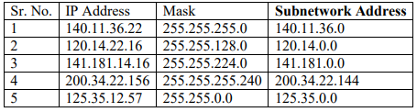
Find the subnetwork address for the following.

Slide 26
Extracting Block Information in Classless Addressing
An address in slash notation (CIDR) contains all information we need about the block: the first address (network address), the number of addresses, and the last address.
These three pieces of information can be found as follows:
Number of addresses in the block N = 2³² − n, in which n is the prefix length and N is the number of addresses in the block.
First address = (any address) AND (network mask)
Last address = (any address) OR [NOT (network mask)]

Slide 27
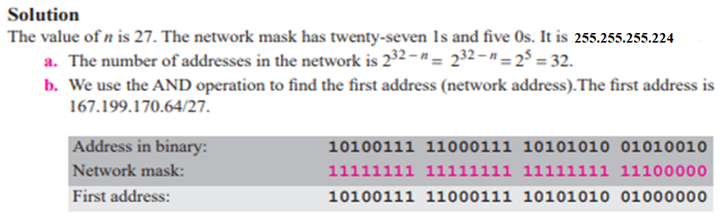
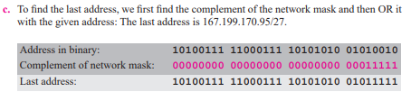
Q. One of the addresses in a block is 167.199.170.82/27. Find the number of addresses in the network, the first address, and the last address.

Slide 28
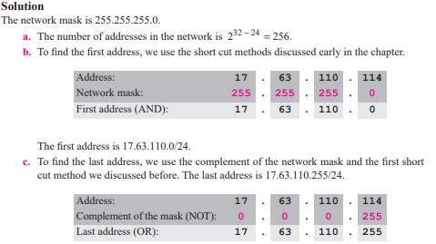
Q. One of the addresses in a block is 17.63.110.114/24. Find the number of addresses, the first address, and the last address in the block.

Slide 29

Designing Subnets
The subnetworks in a network should be carefully designed to enable the routing of packets.
We assume the total number of addresses granted to the organization is N, the prefix length is n, the assigned number of addresses to each subnetwork is N_{sub}, the prefix length for each subnetwork is n_{sub}, and the total number of subnetworks is s.
Then, the following steps need to be carefully followed to guarantee the proper operation of the subnetworks.
The number of addresses in each subnetwork should be a power of 2.
The prefix length for each subnetwork should be found using the following formula:
The starting address in each subnetwork should be divisible by the number of addresses in that subnetwork. This can be achieved if we first assign addresses to larger networks.

Slide 30
Q. An organization is granted the block 130.34.12.64/26. The organization needs four subnetworks, each with an equal number of hosts. Design the subnetworks and find the information about each network.
Solution:
The number of addresses N in the block can be found using
N = 2^{32−n} = 2³²⁻²⁶ = 2⁶ = 64
Network Mask : 255.255.255.192
First address = (any address) AND (network mask) = 130.34.12.64/26 AND 255.255.255.192 = 130.34.12.64/26
Last address = (any address) OR [NOT (network mask)] =130.34.12.64/26 OR [NOT 255.255.255.192]
= 130.34.12.64/26 OR 0.0.0.63 = 130.34.12.127/26
We now design the subnetworks:
We grant 16 addresses for each subnetwork to meet the first requirement (64/16 is a power of 2).
The subnetwork mask for each subnetwork is:
3. We grant 16 addresses to each subnet starting from the first available address.

Slide 31
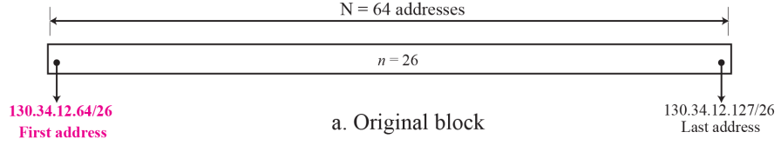
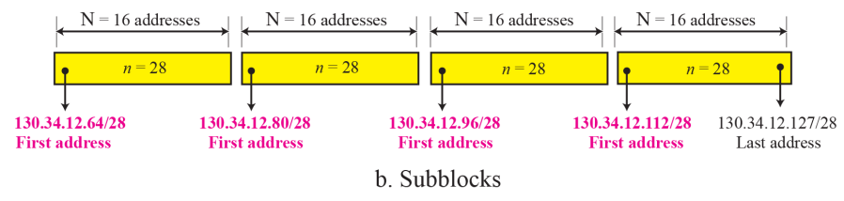

Slide 32
Q. An organization is granted a block of addresses with the beginning address 14.24.74.0/24. The organization needs to have 3 subblocks of addresses to use in its three subnets as shown below:
❑ One subblock of 120 addresses.
❑ One subblock of 60 addresses.
❑ One subblock of 10 addresses.
Solution:
There are 2³² ⁻ ²⁴ = 256 addresses in this block.
Network Mask : 255.255.255.0
First address = (any address) AND (network mask) = 14.24.74.0/24 AND 255.255.255.0 = 14.24.74.0/24
Last address = (any address) OR [NOT (network mask)] =14.24.74.0/24 OR [NOT 255.255.255.0]
= 130.34.12.64/26 OR 0.0.0.255 = 14.24.74.255/24
Given, One subblock of 120 addresses. The number of addresses in the first subblock is not a power of 2. We allocate 128 addresses. The first can be used as network address and the last as the special address. There are still 126 addresses available. The subnet mask for this subnet can be found as n₁ = 24 + log₂ (256/128) = 25. The first address in this block is 14.24.74.0/25; the last address is 14.24.74.127/25.
Given, One subblock of 60 addresses. The number of addresses in the second subblock is not a power of 2 either. We allocate 64 addresses. The first can be used as network address and the last as the special address. There are still 62 addresses available. The subnet mask for this subnet can be found as n₁ = 24 + log₂ (256/64) = 26. The first address in this block is 14.24.74.128/26; the last address is 14.24.74.191/26.
Given, One subblock of 10 addresses. The number of addresses in the third subblock is not a power of 2 either. We allocate 16 addresses. The first can be used as network address and the last as the special address. There are still 14 addresses available. The subnet mask for this subnet can be found as n₁ = 24 + log₂ (256/16) = 28. The first address in this block is 14.24.74.192/28; the last address is 14.24.74.207/28.
If we add all addresses in the previous subblocks, the result is 208 addresses, which means 48 addresses are left in reserve. The first address in this range is 14.24.74.209. The last address is 14.24.74.255. We don’t know about the prefix length yet.

Slide 33
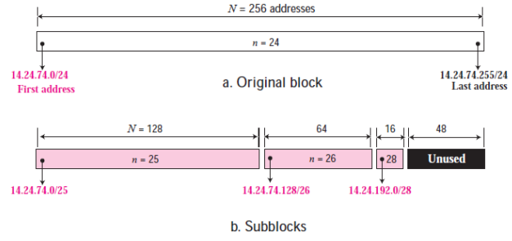

Slide 34
IPv4 Datagram Header
Datagram is a part of IPV4 Header. It represents the Header and payload size.
Datagram of IPV4 is a 16 bit field which is equal to 65535 bytes.
IPV4 Datagram is the combination of header size and payload (data). IPV4 Datagram will always be in the range of 20 bytes to 65535 bytes (2¹⁶ bytes).
1. Header Size
The minimum size of header is 20 bytes or 160 bits and maximum of 60 bytes or 480 bits. First five rows of IPV4 header are mandatory, having total size of 20 bytes.
2. Payload
The minimum size of Payload (Data) is 0 bytes and maximum of 65515 bytes.
IPv4 Datagram Header Size Calculations
If header size is 20 bytes (minimum) and payload is 0 bytes (minimum) then datagram size = 20 bytes
If header size is 20 bytes (minimum) and payload is 65515 (maximum) then datagram size = 65535 bytes
If header size is 60bytes then the payload maximum value will be 65475. Because 65475 + 60 bytes are equal to maximum IPV4 datagram size which is equal to 65535.

Slide 35
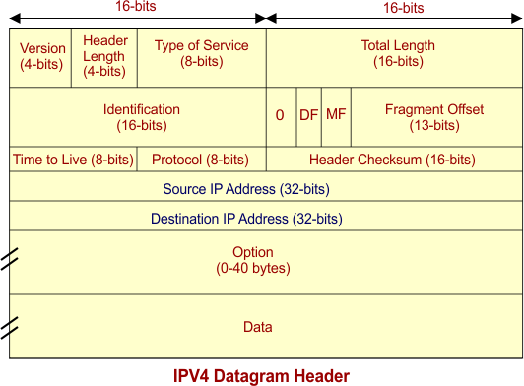
IPV4 Datagram Header Attributes
VERSION: Version of the IP protocol is of 4 bits. These 4 bits are always fixed as 0100 to represent 4 in decimal for IPv4.
HLEN: IPv4 header length is of 4 bits. The minimum value for this field is 5 and the maximum is 15 bytes. Header length = Header length field value x 4 bytes E.g. If header length field contains decimal value 11 (represented in binary 1011) then Header length = 11 x 4 = 44 bytes.
Type Of Service: It is an 8-bit field that is used for Quality of Service. The division of 8-bits are explained under:
Precedence (3 bits): First 3 bits define the precedence. Precedence means priority i.e., immediate, routine etc. If a router is congested and needs to discard a packets, it will discard packets having lowest priority first. Bits values will be 0 or 1.
Delay (1 bit): if we want a minimum delay in data packets then this field will be 1 otherwise 0. It is mostly used in video calling where it needs no delay.
Throughput (1 bit): If need is of high output, then its field bit will be 1 otherwise 0.
Reliability (1 bit): If need is of high reliability, then its field bit will be 1 otherwise 0. It is used where no data loss is tolerated.
Cost (1 bit): If need is of low cost, then this field bit will be 1 otherwise 0. It is required when we need to select the shortest path to reach destination.
Last bit is reserved for future purpose which mostly controls the congestion Notification. Congestion Notification means it inform sender to minimize the speed of sending data.

Slide 36
Total Length: It is Total length of the datagram. It is a 16-bit field which can represent 2¹⁶ = 65536 value . It has minimum size of 20 bytes and max value of 65535 bytes.
Identification: It is a 16-bit field. It is helpful for the identification of the fragments of an original datagram. When an IP datagram is fragmented, each fragmented datagram is assigned the same identification header number. This header number is useful during the re-assembly of fragmented datagrams.
Flag Bits: It use 3 flag bits. First flag bit is Reserved. Second Flag bit (DF Bit). DF bit stands for Do Not Fragment bit. DF value may be 0 or 1. When DF value is 0 then It gives the permission to the intermediate devices (i.e., routers) to fragment the datagram if required. When DF value is 1 then It indicates the intermediate devices (i.e., router) not to fragment the datagram at any cost. Third flag bit is MF. MF bit stands for More Fragments bit. MF value may be 0 or 1. When MF bit value is 0 then it tells to the receiver that the current datagram-fragment is the last fragment and no more segment will appear of same datagram. When MF bit value is 1 then it tells more fragments are still to come after this fragment. MF bit is set to 1 for all the fragments except the last one.
Fragment Offset: Fragment Offset is a 13 bit field. It tells the position of a fragmented datagram in the original un-fragmented IP datagram.
Time to live: Time to live (TTL) is 8-bit field. It indicates the maximum number of hops a datagram can take to reach the destination. The main purpose of TTL is to prevent the IP datagrams from looping around forever in a routing loop. If the value of TTL becomes zero before reaching the destination, then datagram is discarded.
Protocol: it is an 8-bit number that defines what protocol is used inside the IP packet. TCP, UDP, ICMP or IGMP protocols can be filtered on, although they are most common. Protocol number of ICMP is 1 (in binary 00000001), IGMP is 2 (in binary 00000010), TCP is 6 and UDP is 17.
Header Checksum: It is a 16 bits field. It is used for checking errors in the datagram header.
Source IP address: 32 bits IP address of the sender.
Destination IP address: 32 bits IP address of the receiver.
Option: Due to options field, datagram-header-size can be of variable length (20 bytes to 60 bytes).

Slide 37
Network Address Translation (NAT)
To access the Internet, one public IP address is needed, but we can use a private IP address in our private network.
The idea of NAT is to allow multiple devices to access the Internet through a single public address.
To achieve this, the translation of a private IP address to a public IP address is required.
Network Address Translation (NAT) is a process in which one or more local IP address is translated into one or more Global IP address and vice versa in order to provide Internet access to the local hosts.
Also, it does the translation of port numbers i.e. masks the port number of the host with another port number, in the packet that will be routed to the destination.
It then makes the corresponding entries of IP address and port number in the NAT table. NAT generally operates on a router or firewall.

Slide 38
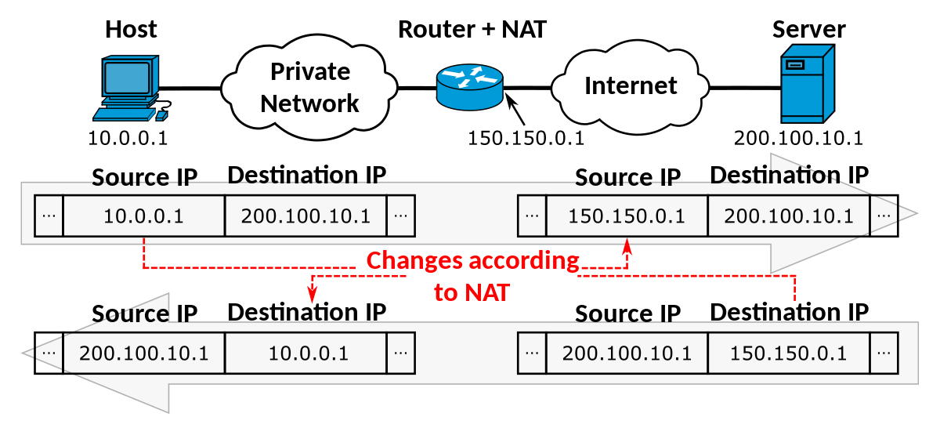
Simplified overview of how NAT works
A device on the private network sends a request to access the internet.
The router on the private network receives the request and replaces the private IP address of the device with its own public IP address.
The router then sends the request to the internet using its public IP address.
When the response is received from the internet, the router uses its translation table to map the public IP address back to the private IP address of the original device and forwards the response to that device.

Slide 39
Example of NAT
Let’s say that there is a laptop connected to a home network using NAT.
That network eventually connects to a router that addresses the internet.
Suppose that someone uses that laptop to search for directions to their favorite restaurant.
The laptop is using NAT. So, it sends this request in an IP packet to the router, which passes that request along to the internet and the search service you’re using.
But before your request leaves your home network, the router first changes the internal IP address from a private local IP address to a public IP address.
Your router effectively translates the private address you’re using to one that can be used on the internet, and then back again.
Now you know that your humble little cable modem or DSL router has a little, automated translator working inside of it.
If the packet keeps a private address, the receiving server won’t know where to send the information back to. This is because a private IP address cannot be routed onto the internet.
If your router were to try doing this, all internet routers are programmed to automatically drop private IP addresses.
The nice thing is, though, that all routers sold today for home offices and small offices can readily translate back and forth between private IP addresses and publicly-routed IP addresses.

Slide 40
Types of NAT
Static NAT: Here, a specific private IP address is always mapped to a specific public IP address.
Dynamic NAT: Here, a pool of public IP addresses are used to map to private IP addresses on an as-needed basis.
Port Address Translation (PAT): Here, a single public IP address is used to map multiple private IP addresses by using different ports to identify each device.

Slide 41
Advantages of NAT
NAT conserves legally registered IP addresses.
It provides privacy as the device’s IP address, sending and receiving the traffic, will be hidden.
Eliminates address renumbering when a network evolves.

Slide 42
Disadvantage of NAT
Translation results in switching path delays.
Certain applications like online gaming, and VOIP (Skype) will not function while NAT is enabled.
Complicates tunneling protocols such as IPsec.
Also, the router being a network layer device, should not tamper with port numbers(transport layer) but it has to do so because of NAT.

Slide 43
Routing Algorithms
One of the functions of the network layer is to route the packets from the source machine to the destination machine.
The major area of the network layer design includes the algorithms which choose the routes and the data structures which are used.
Routing algorithm is a part of network layer software which is responsible for deciding the route/path over which a packet is to be sent.
Types of Routing Algorithms:
Static Routing or Non-Adaptive Routing
It follows user defined routing and routing table is not changed until network administrator changes it.
Static Routing uses simple routing algorithms and provides more security than dynamic routing.
Dynamic Routing or Adaptive Routing
As the name suggests, dynamic routing changes the routing table once any changes to network occurs or network topology changes.
During network change, dynamic routing sends a signal to router, recalculates the routes and send the updated routing information.

Slide 44
Static Routing Vs Dynamic Routing
Sr. No. | Key | Static Routing | Dynamic Routing
1. | Routing pattern | In static routing, user defined routes are used in routing table. | In dynamic routing, routes are updated as per the changes in network.
2. | Routing Algorithm | No complex algorithm used to figure out shortest path. | Dynamic routing employs complex algorithms to find the shortest routes.
3. | Security | Static routing provides higher security. | Dynamic routing is less secure.
4. | Automation | Static routing is a manual process. | Dynamic routing is an automatic process.
5. | Applicability | Static routing is used in smaller networks. | Dynamic routing is implemented in large networks.
6. | Protocols | Static routing may not follow any specific protocol. | Dynamic routing follows protocols like BGP, RIP and EIGRP.
7. | Additional Resources | Static routing does not require any additional resources. | Dynamic routing requires additional resources like memory, bandwidth etc.

Slide 45
Routing Algorithms Dijkstra’s Shortest Path Algorithm
Dijkstra's shortest path algorithm is a graph search algorithm that solves the single-source shortest path problem for a graph with non-negative edge weights, producing the shortest path tree. This algorithm is often used in routing and as a subroutine in other graph algorithms.
The algorithm works by maintaining a set of vertices whose shortest distance from the source vertex is known, and gradually expanding this set until all vertices have been included.
At each step, the algorithm chooses the vertex with the smallest known distance from the source, adds it to the set of known vertices, and updates the distances to its neighbors. This process continues until the destination vertex is reached or all vertices have been visited.
To implement Dijkstra's algorithm, one can use a priority queue to keep track of the vertices with the smallest known distance, with the distance to each vertex being the priority.
The algorithm begins by initializing the distance to the source vertex to 0 and the distance to all other vertices to infinity. It then inserts the source vertex into the priority queue.
The algorithm then repeatedly extracts the vertex with the smallest distance from the priority queue and updates the distances to its neighbors.
If the new distance is smaller than the previous distance, the neighbor's distance is updated and it is inserted into the priority queue. This process continues until the destination vertex is extracted from the priority queue or the priority queue is empty.
Once the algorithm has finished, the shortest path from the source vertex to any other vertex can be found by following the edges of the shortest path tree from the source to the destination vertex.

Slide 46
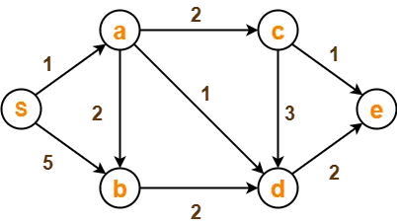
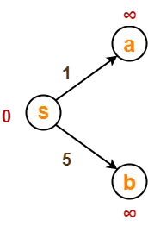
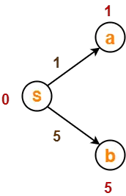
Routing Algorithms Dijkstra’s Shortest Path Algorithm
Using Dijkstra’s Algorithm, find the shortest distance from source vertex ‘S’ to remaining vertices in the following graph
Step-03:
Vertex ‘S’ is chosen.
This is because shortest path estimate for vertex ‘S’ is least.
The outgoing edges of vertex ‘S’ are relaxed.
Before Edge Relaxation-
Step-01:
The following two sets are created-
Unvisited set : {S , a , b , c , d , e}
Visited set : { }
Now,
d[S] + 1 = 0 + 1 = 1 < ∞
∴ d[a] = 1 and Π[a] = S
d[S] + 5 = 0 + 5 = 5 < ∞
∴ d[b] = 5 and Π[b] = S
Step-02:
The two variables Π and d are created for each vertex and initialized as-
Π[S] = Π[a] = Π[b] = Π[c] = Π[d] = Π[e] = NIL
d[S] = 0
d[a] = d[b] = d[c] = d[d] = d[e] = ∞
After edge relaxation, our shortest path tree is-
Now, the sets are updated as-
Unvisited set : {a , b , c , d , e}
Visited set : {S}

Slide 47
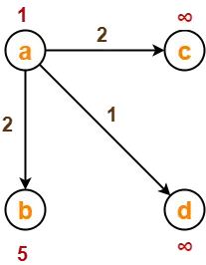
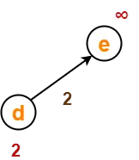
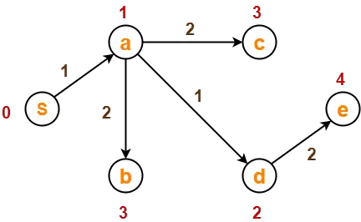
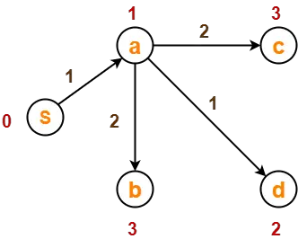
Step-04:
Vertex ‘a’ is chosen.
This is because shortest path estimate for vertex ‘a’ is least.
The outgoing edges of vertex ‘a’ are relaxed.
Step-05:
Vertex ‘d’ is chosen.
This is because shortest path estimate for vertex ‘d’ is least.
The outgoing edges of vertex ‘d’ are relaxed.
Before Edge Relaxation-
Before Edge Relaxation-
Now,
d[a] + 2 = 1 + 2 = 3 < ∞
∴ d[c] = 3 and Π[c] = a
d[a] + 1 = 1 + 1 = 2 < ∞
∴ d[d] = 2 and Π[d] = a
d[b] + 2 = 1 + 2 = 3 < 5
∴ d[b] = 3 and Π[b] = a
Now,
d[d] + 2 = 2 + 2 = 4 < ∞
∴ d[e] = 4 and Π[e] = d
After edge relaxation, our shortest path tree is-
After edge relaxation, our shortest path tree is-
Now, the sets are updated as-
Now, the sets are updated as-
Unvisited set : {b , c , d , e}
Visited set : {S , a}
Unvisited set : {b , c , e}
Visited set : {S , a , d}

Slide 48
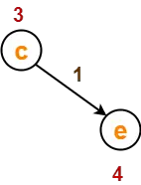

Step-06:
Vertex ‘b’ is chosen.
This is because shortest path estimate for vertex ‘b’ is least.
Vertex ‘c’ may also be chosen since for both the vertices, shortest path estimate is least.
The outgoing edges of vertex ‘b’ are relaxed.
Step-07:
Vertex ‘c’ is chosen.
This is because shortest path estimate for vertex ‘c’ is least.
The outgoing edges of vertex ‘c’ are relaxed.
Before Edge Relaxation-
Before Edge Relaxation-
Now,
d[c] + 1 = 3 + 1 = 4 = 4
∴ No change
Now,
d[b] + 2 = 3 + 2 = 5 > 2
∴ No change
After edge relaxation, our shortest path tree remains the same as in Step-05.
Now, the sets are updated as-
Unvisited set : {c , e}
Visited set : {S , a , d , b}
After edge relaxation, our shortest path tree remains the same as in Step-05.
Now, the sets are updated as-
Unvisited set : {e}
Visited set : {S , a , d , b , c}

Slide 49
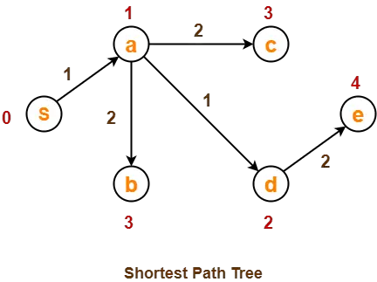
Step-08:
Vertex ‘e’ is chosen.
This is because shortest path estimate for vertex ‘e’ is least.
The outgoing edges of vertex ‘e’ are relaxed.
There are no outgoing edges for vertex ‘e’.
So, our shortest path tree remains the same as in Step-05.
Now, the sets are updated as-
Unvisited set : { }
Visited set : {S , a , d , b , c , e}
Now,
All vertices of the graph are processed.
Our final shortest path tree is as shown below.
It represents the shortest path from source vertex ‘S’ to all other remaining vertices.
The order in which all the vertices are processed is :
S , a , d , b , c , e.

Slide 50
Distance Vector Routing
Distance vector routing is a routing algorithm used in computer networks to determine the best path for routing data packets between nodes.
It works by each node maintaining a table that lists the cost of sending a packet to all other nodes in the network and then using this information to determine the best path for each packet.
The basic idea behind distance vector routing is that each node sends its routing table to its neighbors at regular intervals, and each node updates its own routing table based on the information it receives from its neighbors. This process continues until all nodes have a consistent view of the network topology and the best path for each destination.
The cost of sending a packet from one node to another can be measured in terms of various metrics, such as the number of hops, the available bandwidth, or the delay.
The most commonly used metric is the number of hops, which represents the number of intermediate nodes that the packet must traverse to reach its destination.
One of the main advantages of distance vector routing is its simplicity and low overhead. However, it can also suffer from several drawbacks, such as slow convergence, routing loops, and count-to-infinity problems, which can lead to suboptimal routing and network congestion.
A broken link between the routers should be updated to every other router in the network immediately. The distance vector routing takes a considerable time for the updating. This problem is also known as count-to-infinity.
To address these issues, more advanced routing protocols, such as Link State Routing (LSR) and Border Gateway Protocol (BGP), have been developed.

Slide 51
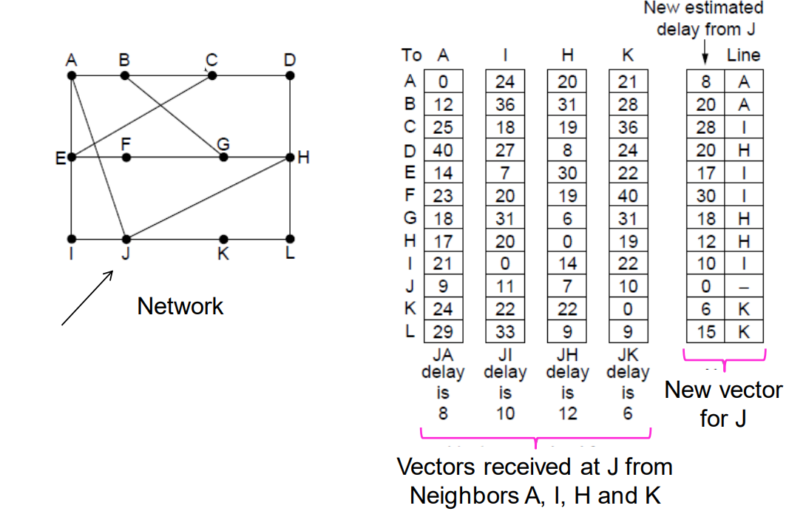
Distance Vector Routing

Slide 52
Link State Routing
Link-state routing protocol is a type of routing protocol used in computer networks to determine the shortest path for data transmission between two nodes.
In this protocol, every node in the network maintains a complete map of the network topology, including all the links and their status.
The nodes then use this information to calculate the shortest path to any other node in the network.
Link-state routing protocols have the following characteristics:
Each node maintains a complete map of the network, which is updated periodically or when a change in the network topology occurs.
The shortest path is calculated using Dijkstra's algorithm or a similar algorithm, which takes into account the link cost and the status of each link.
Each node communicates with its neighboring nodes to exchange information about the network topology and to update its own map.
When a change in the network topology occurs, the affected nodes send out update messages to inform the rest of the network.
Link-state routing protocols are more efficient than distance-vector protocols in large networks because they converge faster and have less routing overhead.
Examples of link-state routing protocols include OSPF (Open Shortest Path First) and IS-IS (Intermediate System-to-Intermediate System). These protocols are commonly used in enterprise networks and the internet backbone.

Slide 53
Phases in Link State Routing
The LSR process can be divided into several phases:
Initialization phase: The first phase is the initialization phase, where each router in the network learns about its own directly connected links. This information is then stored in the router’s link state database.
Flooding phase: The second phase is the flooding phase, where each router floods its link state information to all other routers in the network. This allows each router to learn about the entire network topology.
Path calculation phase: The third phase is the shortest path calculation phase, where each router uses the link state information to calculate the shortest path to every other router in the network. This is typically done using Dijkstra’s algorithm.
Route installation phase: The fourth and final phase is the route installation phase, where each router installs the calculated shortest paths in its routing table. This allows the router to forward packets along the optimal path to their destination.

Slide 54
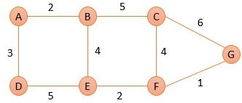
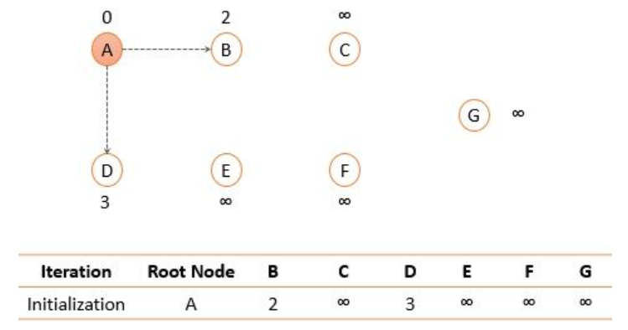
Using Link State Routing, find the shortest path tree for node A.
Solution:
First, we will initialize node A and set the shortest distance to its immediate neighbors.

Slide 55
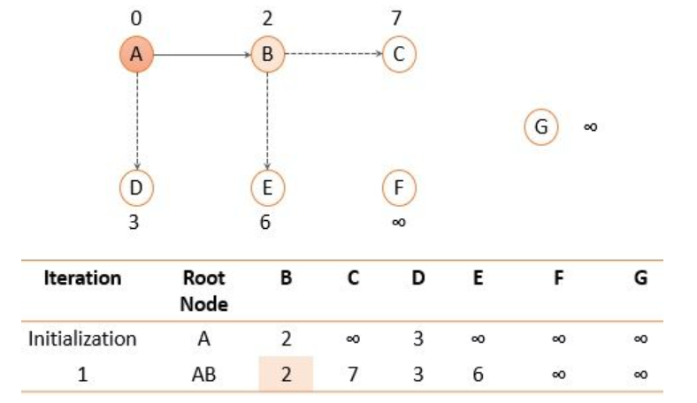
Among the two immediate neighbors of node A, we will add a node to the path that has the shortest distance i.e. node B with the shortest distance 2.

Slide 56
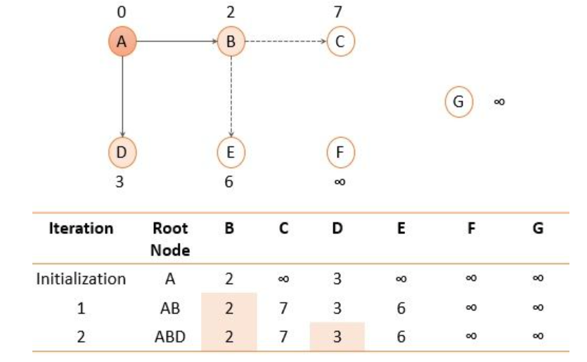
Now search for the nodes that are not added to the path yet (C, D, E) and select the one with the shortest distance i.e. node D.

Slide 57
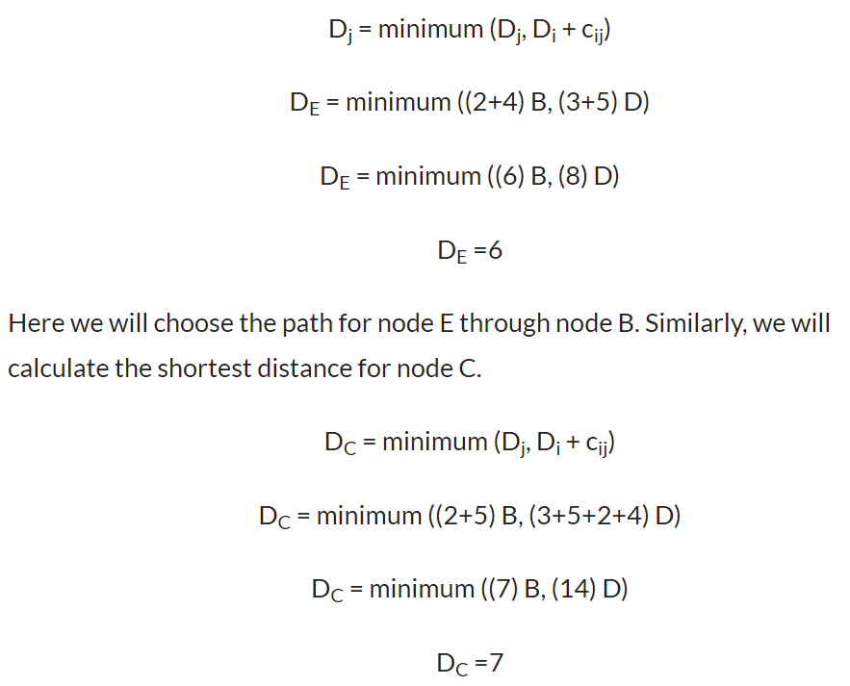
Now, nodes B and D that we added to the path were directly connected to root node A and were at the shortest distance as compared to any other path. Further, we have node E and node C which can be reached by node A through node B or through node D. Let us check out which path is shortest.
Now, node E has the shortest distance so we will add node E to the path.

Slide 58
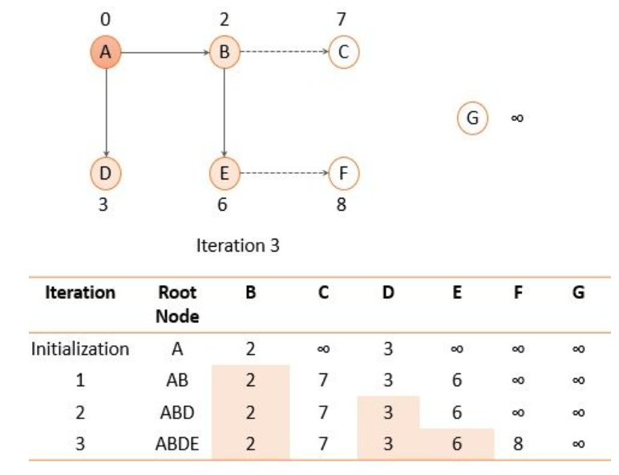
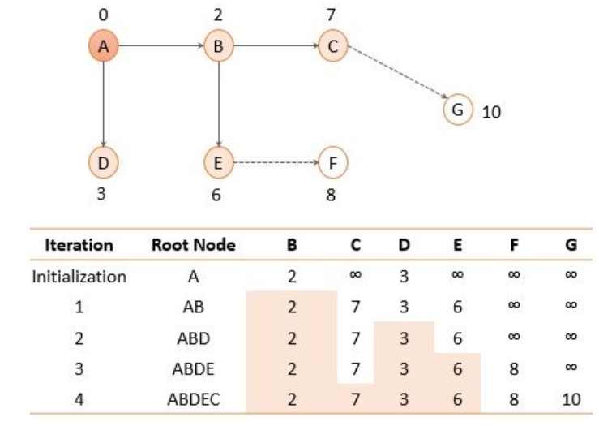
Now we are left with node F and node G we will calculate the shortest distance for node F and G as we calculate for node E and C. Now, among F and G the node with the shortest distance is node F so, we will update and add node F to the path.
After adding node E to the path again explore the nodes that are not added to the path and there enlist their cost as the distance. Again, select the node with the shortest distance so we will add node C to the path.

Slide 59
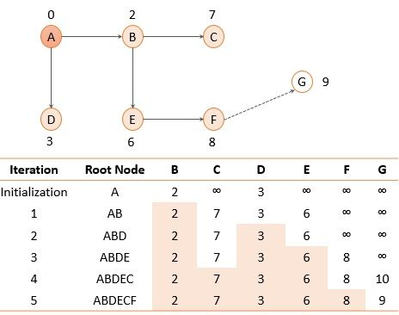
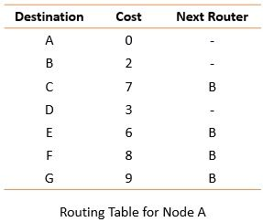
Using the shortest path tree, each router creates a routing table that has three columns destination, cost, and next router. In the figure below, I have given a routing table for router A. Similarly, the routing table is created for all the routers in the domain.
Also, the root node A can reach node G through node F with the shortest distance i.e.9. So finally we add node G.

Slide 60
Distance Vector Routing Vs Link State Routing
Distance Vector Routing | Link State Routing
Bellman ford algorithm is used in distance vector routing | Dijkstra’s algorithm is used in link-state routing
It is simple to use | It needs trained network administrators
Chances of traffic are less | There is more chance of traffic
Convergence time is moderate i.e good news forward fastly as compared to bad news | Convergence time is fast
There is less utilisation of CPU and memory | There is more utilisation of CPU and memory
There is a problem of persistent looping | Only transient looping occurs
Best path is determined by the least number of hops | Best path is determined by the least cost
There is no hierarchical structure | There is a hierarchical structure
Require smaller bandwidth as there is no flooding, small packet and local sharing | Require larger bandwidth for flooding problems and for transmitting large link state packets
It updates tables with information about its neighbours. So, it works based on local information | It has the information of the whole network. So, it works based on global information
It updates on a broadcast basis | It updates on a multicast basis

Slide 61
ARP Vs RARP Routing Protocol
Parameters | ARP | RARP
Full Form | The term ARP is an abbreviation for Address resolution protocol. | The term RARP is an abbreviation for Reverse Address Resolution Protocol.
Basics | The ARP retrieves the receiver’s physical address in a network. | The RARP retrieves a computer’s logical address from its available server.
Broadcast Address | The nodes use ARP broadcasts in the LAN with the help of the MAC address. | The RARP utilises IP addresses for broadcasting.
Table Maintained By | The ARP table is maintained by the Local Host. | The RARP table is maintained by the RARP Server.
Usage | The router or the host uses ARP to find another router/host’s address (physical address) in LAN. | RARP is used by thin clients that have limited facilities.
Reply Information | The primary use of the ARP reply is to update the ARP table. | The primary use of the RARP reply is to configure the local host’s IP address.
Mapping | The ARP maps the node’s IP address (32-bit logical address) to the MAC address/physical address (48-bit address). | The RARP maps the 48-bit address (MAC address/physical address) to the logical IP address (32-bit).

Slide 62
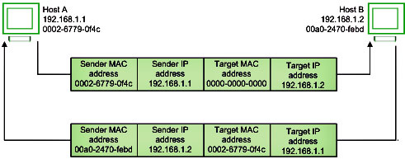

Slide 63
ICMP Protocol
The Internet Control Message Protocol (ICMP) is a network layer protocol used by network devices to diagnose network communication issues.
ICMP is mainly used to determine whether or not data is reaching its intended destination in a timely manner.
Commonly, the ICMP protocol is used on network devices, such as routers.
ICMP is crucial for error reporting and testing, but it can also be used in distributed denial-of-service (DDoS) attacks.

Slide 64
Types of ICMP messages
Category | Type | Message
Error-Reporting Messages | 3 | Destination unreachable
 | 4 | Source quench
 | 11 | Time Exceeded
 | 12 | Parameter Problem
 | 5 | Redirection
Query Message | 8 or 0 | Echo request or reply
 | 13 or 14 | Timestamp request or reply
 | 17 or 18 | Address mask request or reply
 | 10 or 9 | Router Solicitation or advertisement
Information Messages − In this message, the sender sends a query to the host or router and expects an answer. For example, A host wants to know if a router is alive or not.
Error-reporting message − This message report problems that a router or a host (destination) may encounter when it processes an IP packet.
Query Message − It helps a router or a network manager to get specific information from a router or another host.

Slide 65
Source Quench − It requests to decrease the traffic rate of message sending from source to destination.
Time Exceeded − When fragments are lost in a network the fragments hold by the router will be dropped and then ICMP will take the source IP from the discarded packet and inform the source, that datagram is discarded due to the time to live field reaches zero, by sending time exceeded message.
Fragmentation Required − When a router is unable to forward a datagram because it exceeds the MTU of the next-hop network and the DF (Don't Fragment) bit is set, the router is required to return an ICMP Destination Unreachable message to the source of the datagram, with the Code indicating fragmentation is needed and DF (Don’t Fragment) set.
Destination Unreachable − This error message indicates that the destination host, network, or port number that is specified in the IP packet is unreachable. This may happen due to the destination host device is down, an intermediate router is unable to find a path to forward the packet, and a firewall is configured to block connections from the source of the packet.
Redirect Message − A redirect error message is used when a router needs to tell a sender that it should use a different path for a specific destination. It occurs when the router knows a shorter path to the destination.

Slide 66
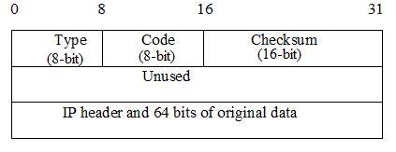
ICMP Basic Error Message Format
A basic ICMP error message would have the following format :
Type − The type field identifies the type of the message.
Code − The code field in ICMP describes the purpose of the message.
Checksum − The checksum field is used to validate ICMP messages.

Slide 67
IGMP
The Internet Group Management Protocol (IGMP) is a protocol that allows several devices to share one IP address so they can all receive the same data.
IGMP is a network layer protocol used to set up multicasting on networks that use the Internet Protocol version 4 (IPv4).
Specifically, IGMP allows devices to join a multicasting group.
Multicasting is when a group of devices all receive the same messages or packets.
Multicasting works by sharing an IP address between multiple devices.

Slide 68
How does IGMP work?
Computers and other devices connected to a network use IGMP when they want to join a multicast group.
A router that supports IGMP listens to IGMP transmissions from devices in order to figure out which devices belong to which multicast groups.
IGMP uses IP addresses that are set aside for multicasting.
Multicast IP addresses are in the range between 224.0.0.0 and 239.255.255.255. (In contrast, anycast networks can use any regular IP address.)
Each multicast group shares one of these IP addresses.
When a router receives a series of packets directed at the shared IP address, it will duplicate those packets, sending copies to all members of the multicast group.
IGMP multicast groups can change at any time. A device can send an IGMP "join group" or "leave group" message at any point.
IGMP works directly on top of the Internet Protocol (IP). Each IGMP packet has both an IGMP header and an IP header.
Just like ICMP, IGMP does not use a transport layers protocol such as TCP or UDP.

Slide 69
Types of IGMP messages
The IGMP protocol allows for several kinds of IGMP messages:
Membership reports: Devices send these to a multicast router in order to become a member of a multicast group.
"Leave group" messages: These messages go from a device to a router and allow devices to leave a multicast group.
General membership queries: A multicast-capable router sends out these messages to the entire connected network of devices to update multicast group membership for all groups on the network.
Group-specific membership queries: Routers send these messages to a specific multicast group, instead of the entire network.

